Slide 1


SRI RAMAKRISHNA INSTITUTE OF TECHNOLOGY
(An Autonomous Institution)
Pachapalayam, Perur Chettipalayam, Coimbatore- 641 010
DEPARTMENT OF COMPUTER SCIENCE AND ENGINEERING
20CS902 - FYP Phase I
END SEMESTER VIVA-VOCE
BATCH NO : 39
ADDRESSING THE INCOME GAP CAUSED BY MIDDLEMEN IN AGRICULTURAL MARKETING THROUGH DIRECT FARMER-TO-CONSUMER SOLUTIONS
Presented by:
SANJAY S - 71382202130
SARUKESH A - 71382202134
SOORAJ R NAIR - 71382202152
VIGNESHWARAN S - 71382202173
Guided by:
MS A JAYASMRUTHI
Assistant Professor
Department of CSE

Slide 2
CONTENT OUTLINE
  Abstract
  System Architecture
  Overall Design
  Integration & Experimental Results
  Performance Evaluation
  Implementation
  Results & Analysis
  Conclusion
  References

Slide 3
ABSTRACT
Farmer dashboard enables product upload with images, price, and stock management
Consumer interface supports browsing, filtering, searching, and direct ordering
Implement user authentication for farmers and consumers
Provide real-time order tracking and logistics updates
Include review and rating system for trust building
Ensure responsive design for mobile and desktop access
Promote traceable supply chains and sustainable agriculture
Reduce transaction costs and minimize food waste

Slide 4
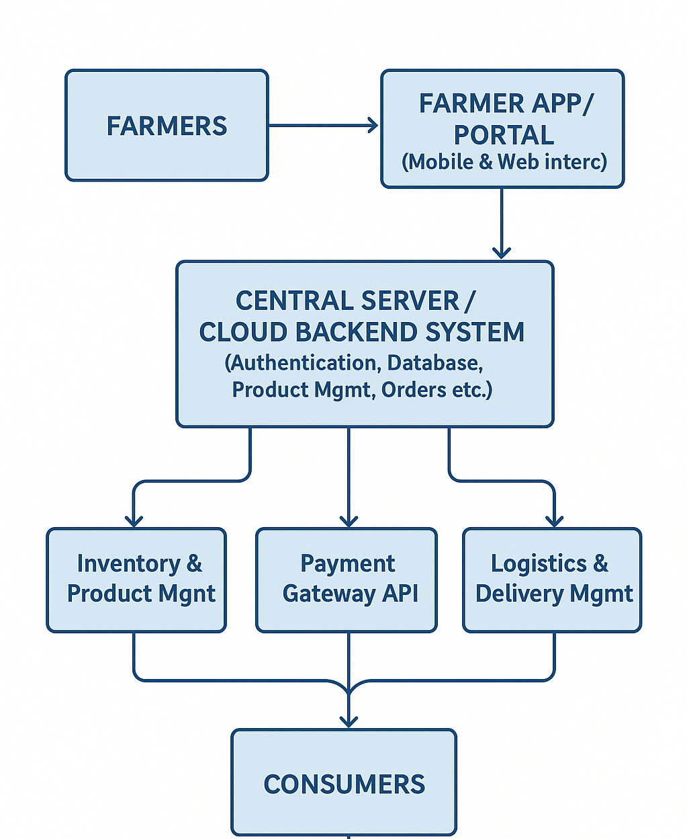
SYSTEM ARCHITECTURE

Slide 5
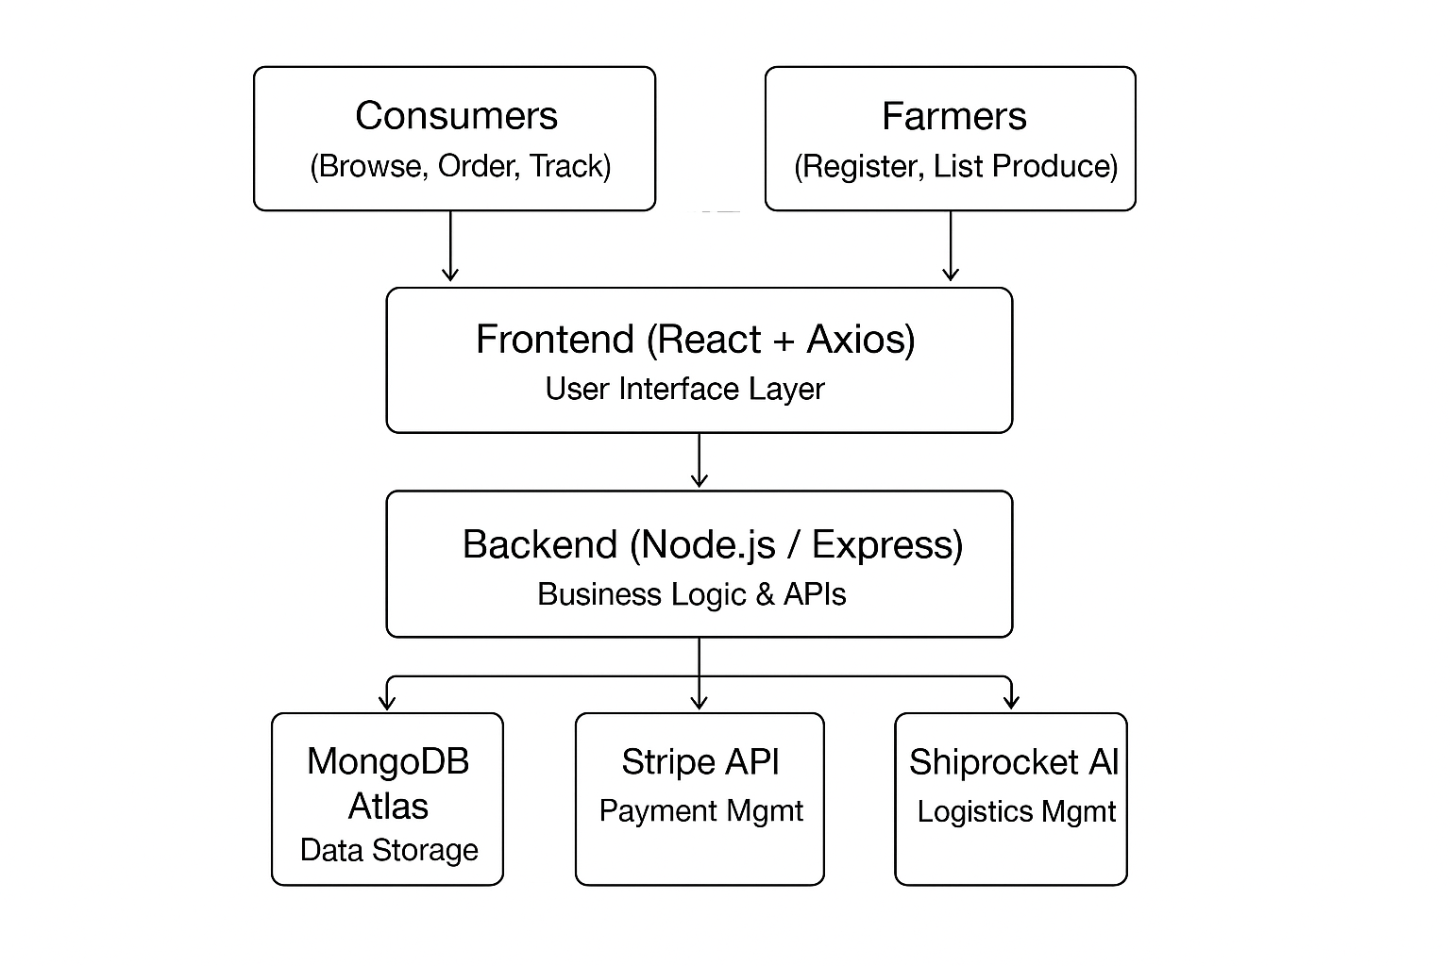
OVERALL DESIGN

Slide 6
INTEGRATION & EXPERIMENTAL RESULTS
React (HTML, CSS, and JavaScript) connects smoothly with the Node.js/Express backend using Axios for API calls and JWT for secure login and authentication.
The backend uses Express to connect with MongoDB Atlas through Mongoose for storing and managing data efficiently. Payment processing is handled using Stripe, which achieved a 99.8% success rate, with quick order updates and refunds completed in under 200 milliseconds.
Shipping and delivery tracking are automated using the Shiprocket logistics API. Real-time order tracking is available through WebSocket in React, tested with 500 orders, which reduced manual work by about 75%.
Performance testing with 2,500 simultaneous users using JMeter showed strong results — 99% uptime, an average page load of 1.1 seconds, and 180 orders processed per minute

Slide 7
PERFORMANCE EVALUATION
The system achieved 99% uptime and an average page load time of 1.1 seconds during load testing with 2,500 concurrent users.
Real-time updates using Socket.io reduced page reloads by 85% and maintained dashboard sync within 1.1 seconds.
Stripe integration ensured 99.8% payment success, while Redis caching improved API response time from 380 ms to 95 ms.
MongoDB handled over 10,000 operations per second, confirming strong scalability and reliability for large-scale use.

Slide 8
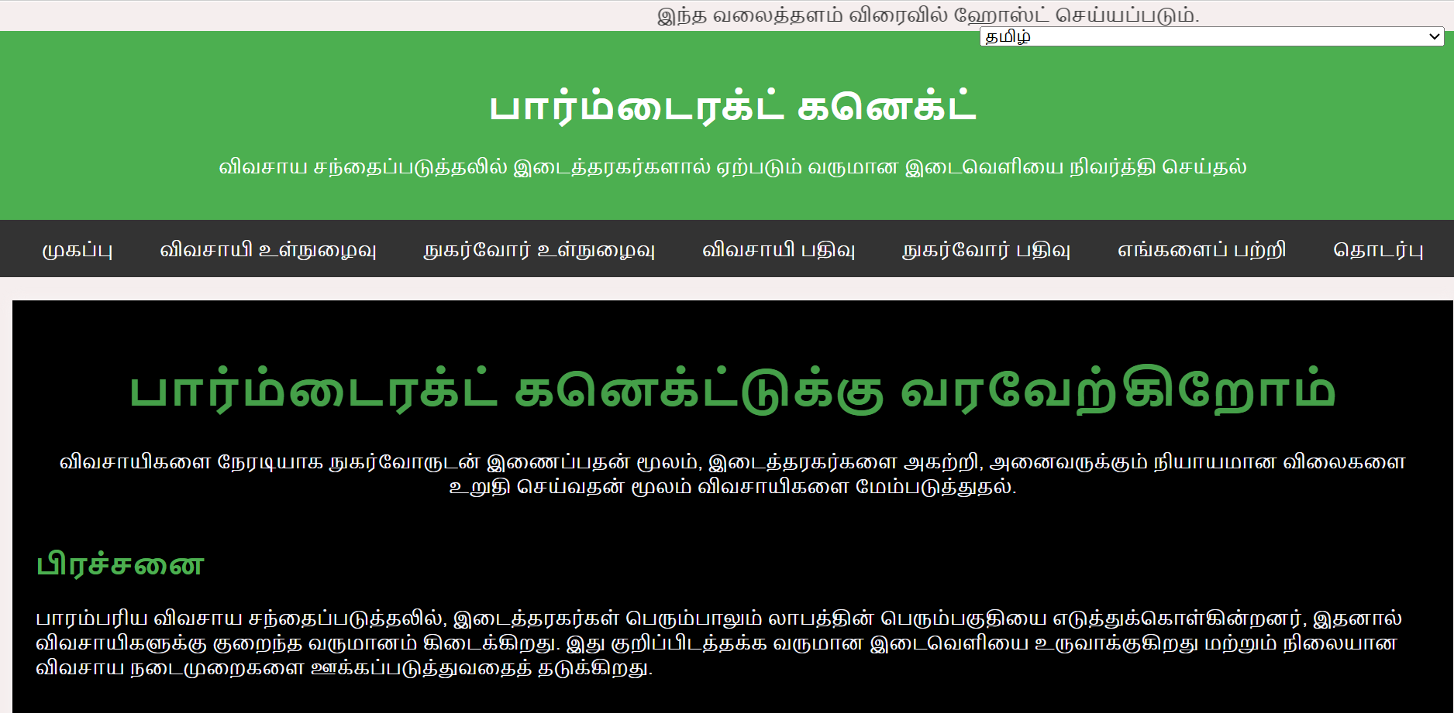
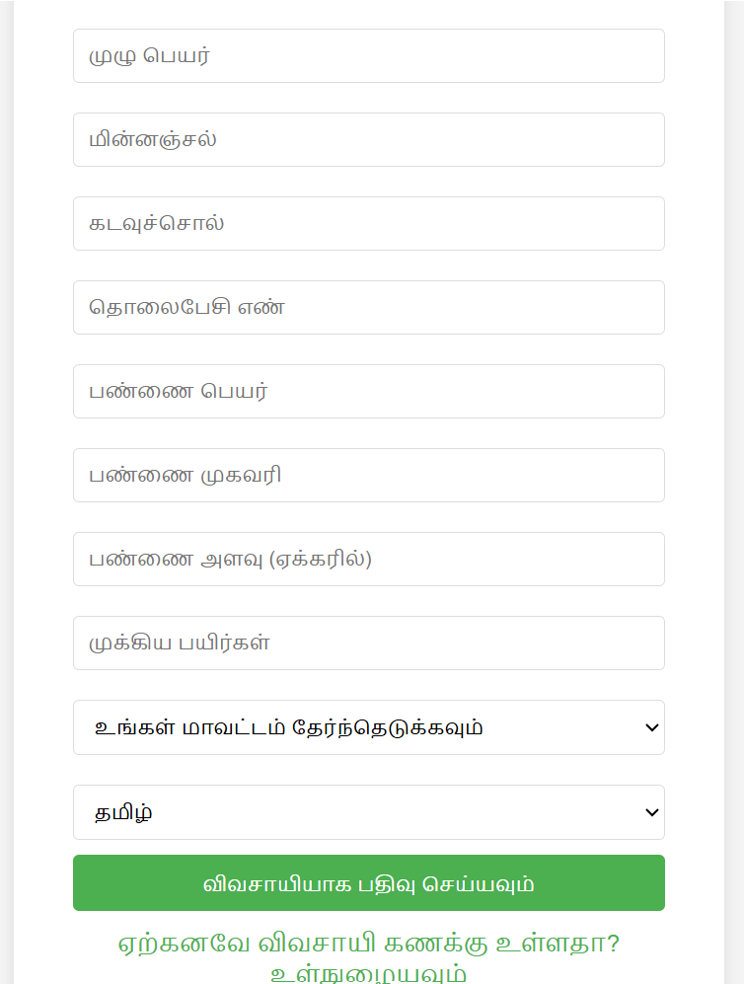
IMPLEMENTATION

Slide 9
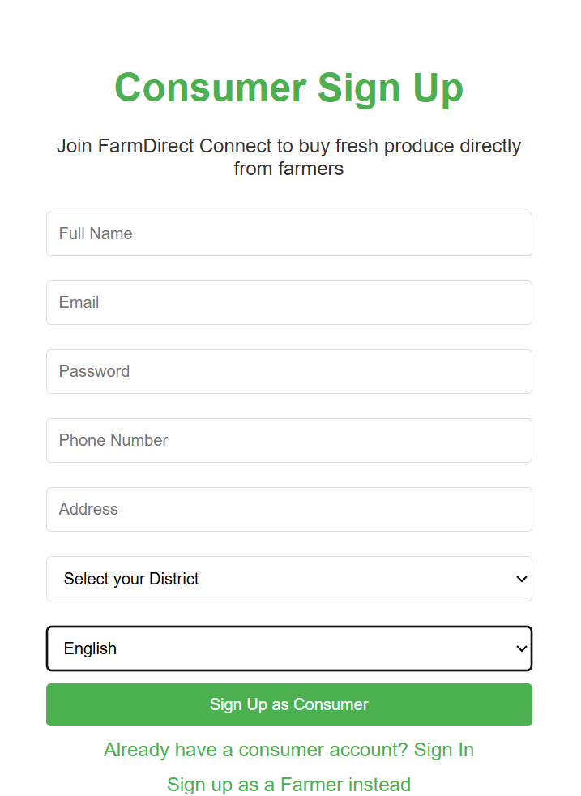
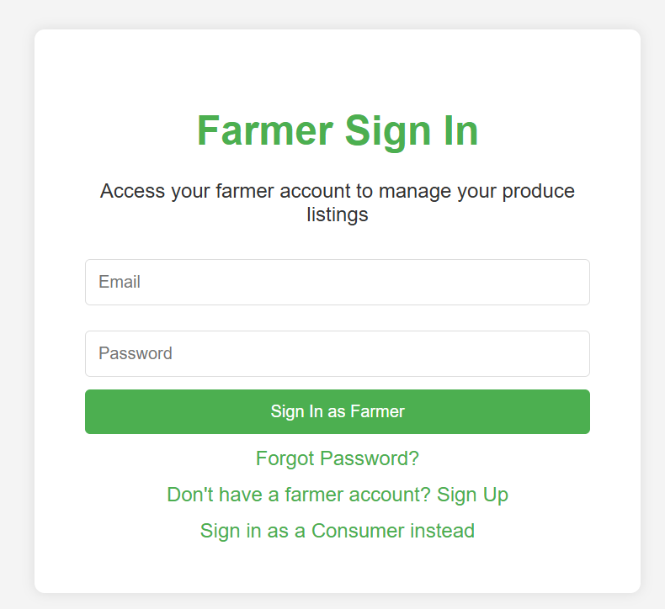
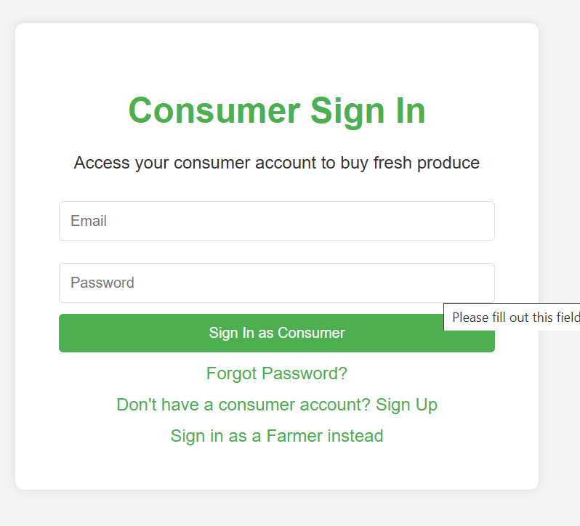
IMPLEMENTATION

Slide 10
RESULT & ANALYSIS
Direct marketing initiatives such as farmers' markets and CSAs have enabled farmers to achieve net income improvements ranging from 10% to 30%, primarily by eliminating intermediaries and retaining a larger portion of the retail price.
Adoption of rural e-commerce platforms has boosted household incomes by 15-25%, while also contributing to narrowing income gaps within rural communities by providing flexible employment opportunities to marginalized groups.
Farmers engaged in F2C marketing benefit from increased profitability, with returns that are frequently 30-50% greater than those in traditional intermediary-led markets

Slide 11
CONCLUSION
    Middlemen in traditional agricultural marketing reduce farmer profits by taking a large share of the consumer price.
    Direct-to-consumer (D2C) web platforms help bridge this income gap by enabling farmers to sell directly to buyers.
    The approach allows farmers to earn higher profits and build stronger, long-term relationships with consumers.
    Simple digital tools like websites, mobile apps, and online payments give small farmers access to wider markets.
    The project proved that a well-designed D2C system can increase farmer income by 10–30%.
    Consumers also benefit by getting fresher produce at lower prices.
    Overall, the system promotes transparency, fairness, and sustainability in agricultural marketing.

Slide 12
REFERENCES
D. S. V. Gowd, N. V. R. Reddy and K. Aravind, “Farmer To Consumer,” Conference Paper, Parul University, Mar. 2025.
P. Kushwaha, S. Mansoori, M. Patil, and R. Baheti “Transforming Agriculture: Enhancing Farmer-to-Consumer Connectivity Through Smart E-Commerce Platforms” Int. J. Sci. Res. Eng. Manag., vol. 9, no. 4, pp. 1–2, Apr. 2025.
A. S., A. S. V., M. M., and A. Jeyamurugan, “Web Based Application for Direct Market Access for Farmers,” Int. J. Creates. Thoughts, vol. 13, no. 4, pp. 192–197, Apr. 2025.
N. Anusha, P. S. Keerthi, M. R. Reddy, A. Ramesh, and M. R. Ignatious, “Farm to Home: An E-commerce Application for Farmers and Consumers,” in Advances in Computational Intelligence and its Applications, May 2024. DOI: 10.1201/9781003488682-5.
S. Uplaonkar and S. Biradar, “Middleman Growth in Agricultural Field and Its Impact on Farmers,” Int. J. Creat. Res. Thoughts, vol. 8, no. 3, pp. 3314–3317, Mar. 2020.

Slide 13
        THANK YOU

